Slide 1


MS Marketing Communication Division
MS Brand Experience Team
2026
Sound Switcher In-store Guideline
May. 2026
Ver 1.

Slide 2

IMPORTANT UPDATE

Slide 3

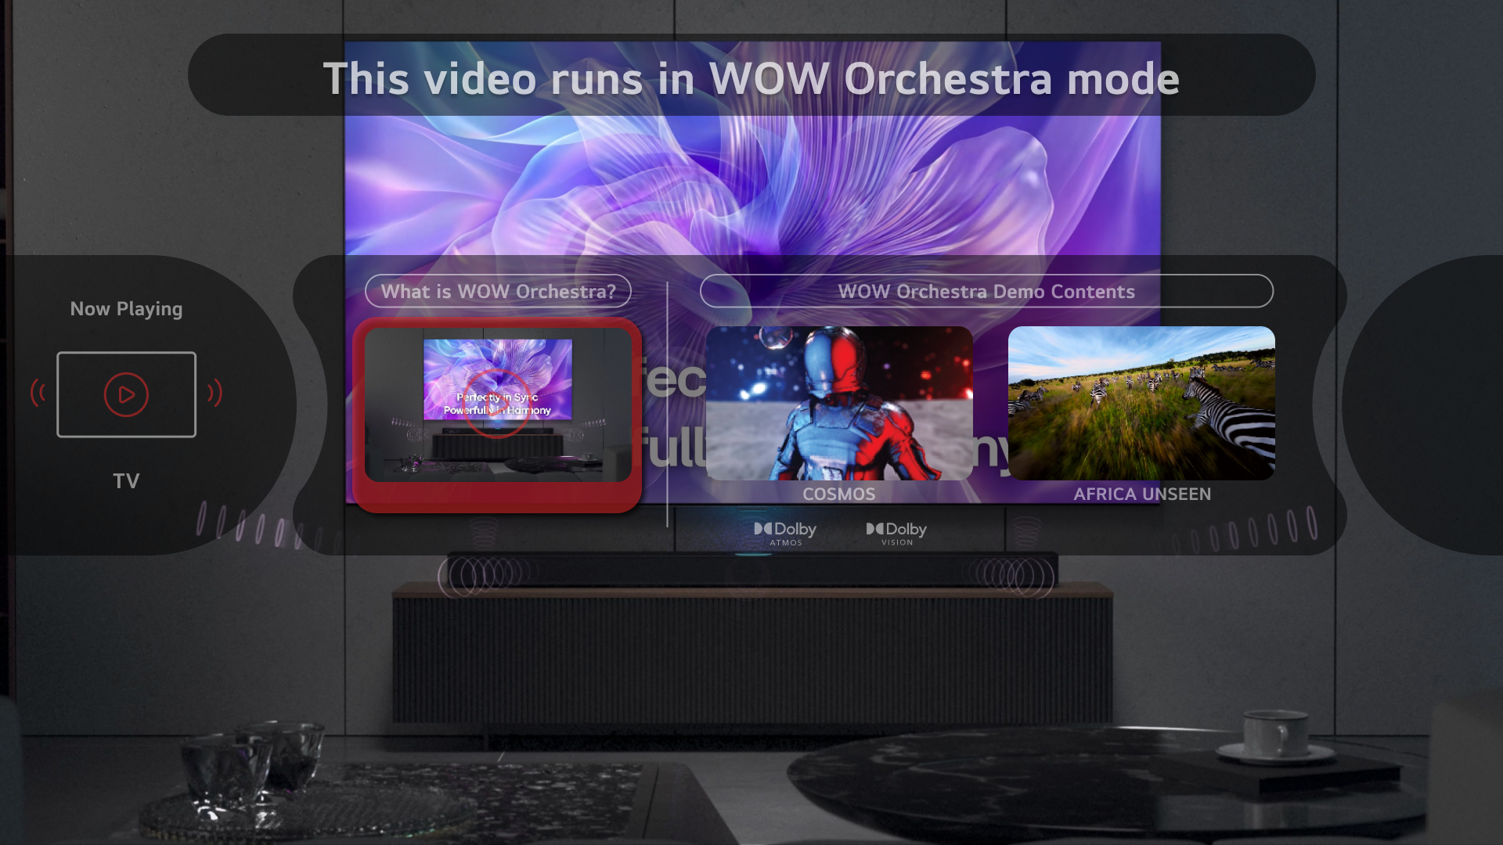
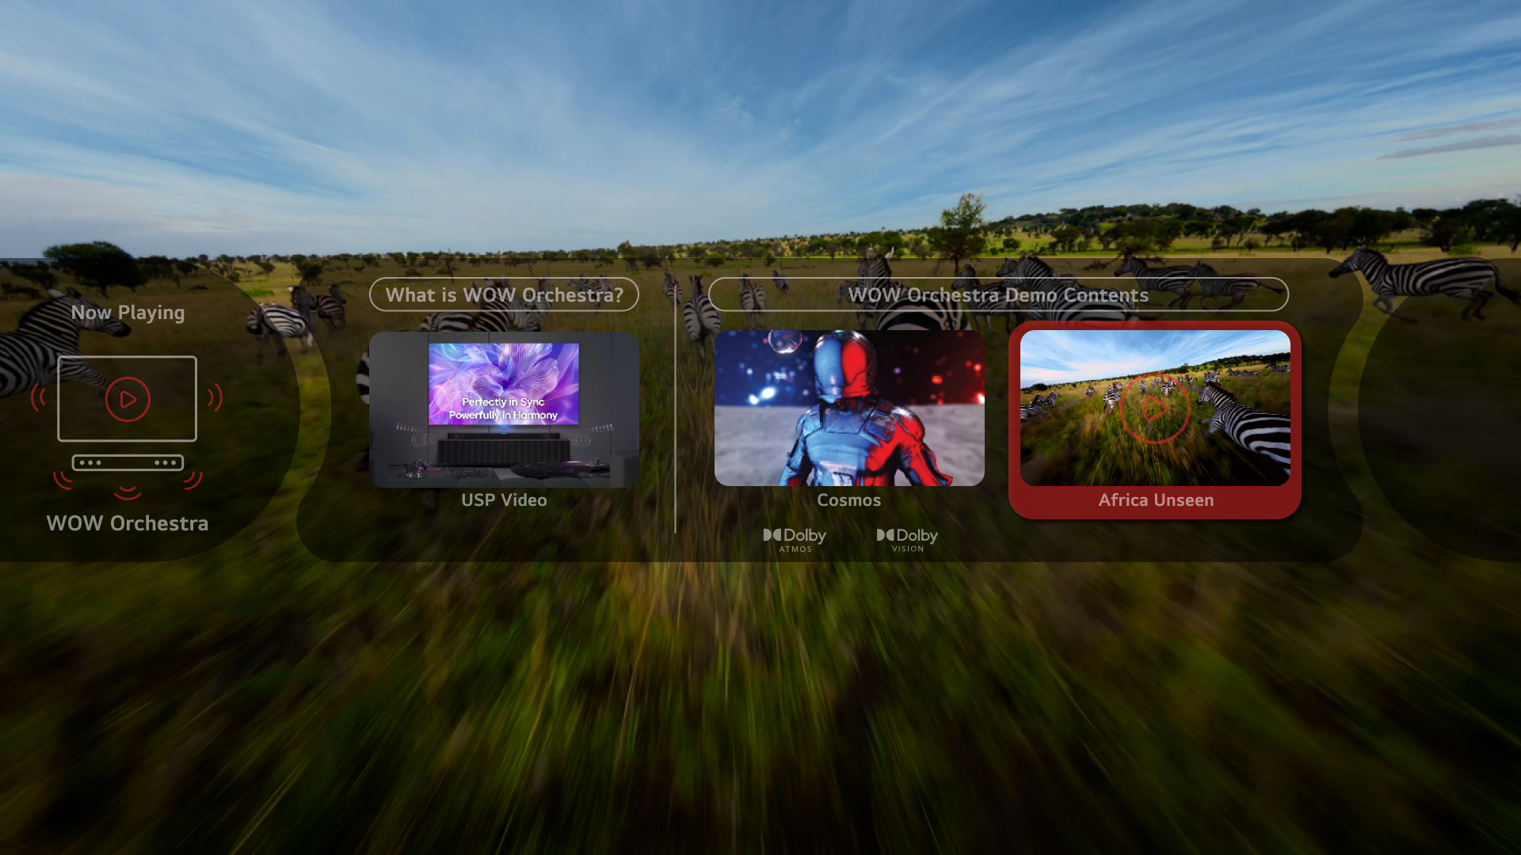
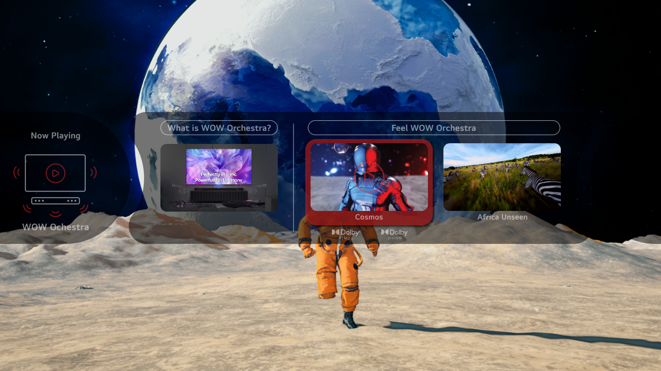
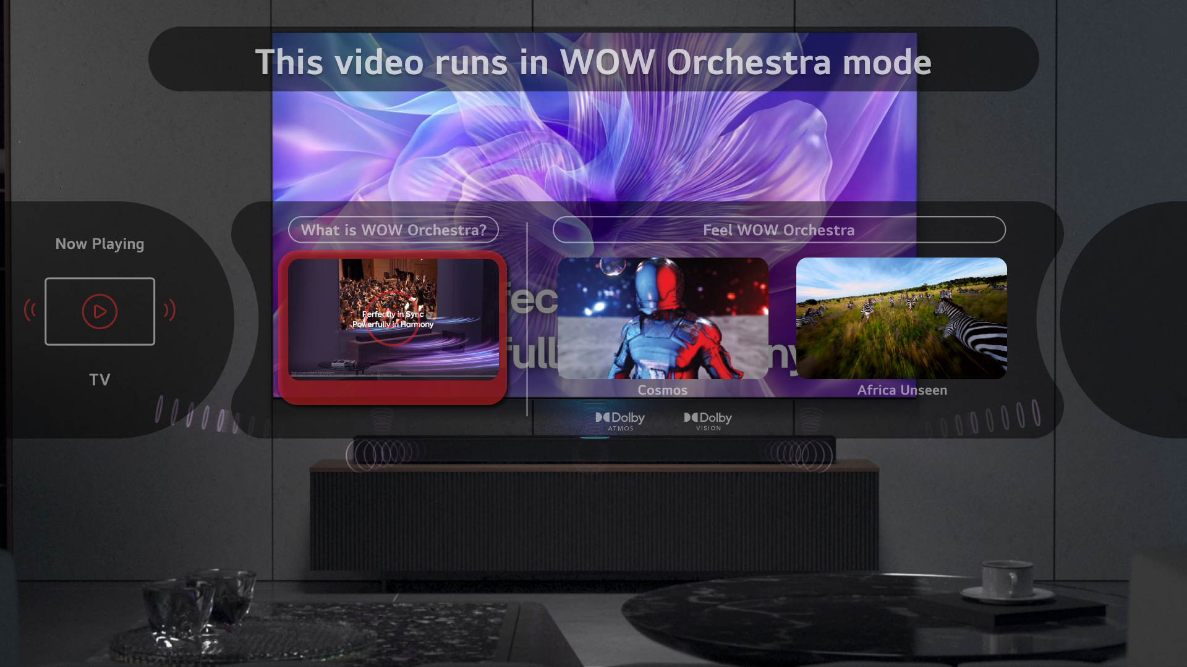
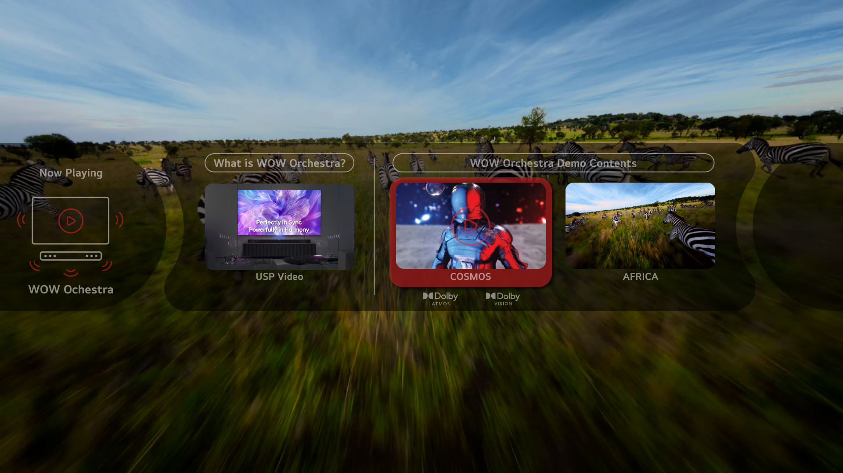
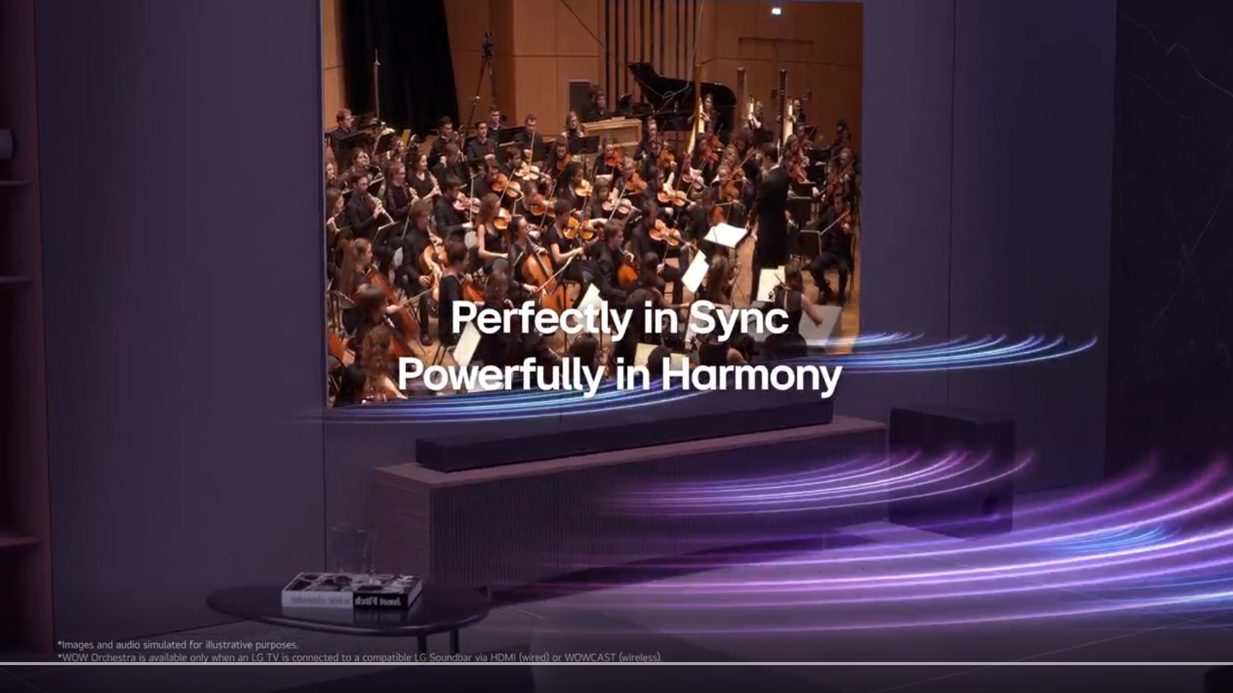
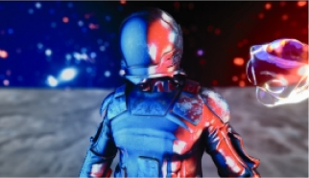
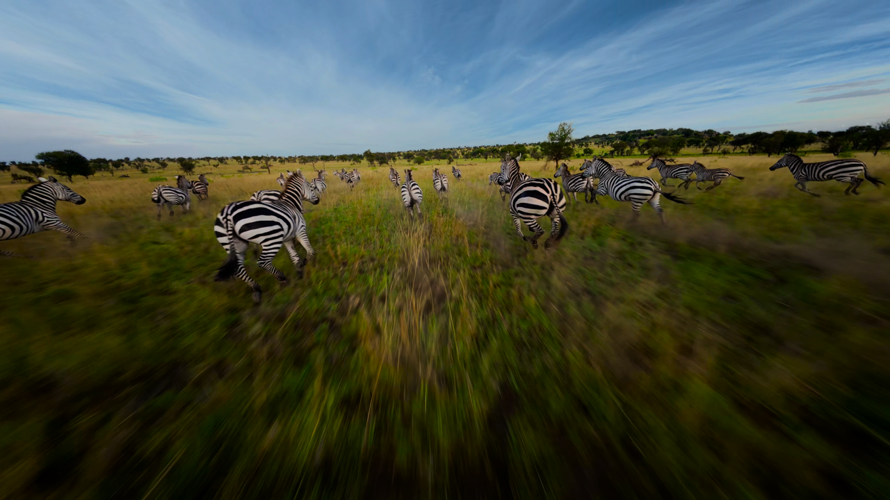
IMPORTANT UPDATE
WOW Orchestra demo with Sound Switcher would be carried on in 2026 for TV-Soundbar synergy experience.
There are 3 major updates since the last distribution of the 2025 Sound Switcher.
MRGB/QNED
Delivery would start from 2nd week of May for those who ordered 2026 Update USB and Switcher Device.
1. Demo Contents Update
2. New Function Update
2025 : Demo Content 1 (Cosmos)
Automatic background video playback when a thumbnail is selected
as-was
to-be
2026 : Total 3 contents for 2026
① What is WOW Orchestra? : Brand New
* Playback mode: WOW Orchestra only
* TV<->WOW output switching: Not supported
② Cosmos : The same as 2025
③ Africa Unseen : Brand New
[What is WOW Orchestra?]
[Cosmos]
[Africa Unseen]
3. Demo App USBs
Due to the unstable USB supply situation this year, we have prepared three different types of USBs.
1) OLED USB, 2) MRGB/QNED USB, 3) All-TV USB (compatible with OLED/MRGB/QNED)
We will distribute the USBs to each subsidiary according to the requested quantities,
so we kindly ask you to carefully check the USB labels before use.
For inquiries regarding the update app, please contact to support site or the email address below.
1. Support Home Page : https://www.lg-instore-support.com
2. Customer Service Email : RYDIS : rydis-cs@rydis.co.kr / HSAD : kyh2013@hsad.co.kr
3. App Developer’s Address : RYDIS Co.,Ltd.
#910, 30, Gasan digital 1-ro, Geumcheon-gu, Seoul, Republic of Korea, 08591
2026 Sound Switcher In-store Guideline
3
LGE INTERNAL USE ONLY

Slide 4


IMPORTANT UPDATE
Please check 2026 Sound Switcher compatible models before installation.
If you connect it with unsupported models, Sound Switcher will not work and error message will pop up.
To make Sound Switcher demo experience have stability, we tested its operation with R&D team and some of subsidiaries.
TV
Soundbar
[2025]
OLED: G/C series
QNED : QNED92 / QNED90 / QNED85
[2026]
OLED: G/C series
MRGB : MRGB95B / MRGB9MB
QNED : QNED90B / QNED85B
S70T series or above models
2026 Sound Switcher In-store Guideline
4
LGE INTERNAL USE ONLY

Slide 5
IMPORTANT UPDATE
‘What is WOW Orchestra?’ is an introduction video of WOW Orchestra and is exclusive to WOW Orchestra output.
TV<->WOW output switching is not supported.
To prevent user confusion, a pop-up message stating “This video runs in WOW Orchestra mode” appears at the top
of the TV screen when customer presses the TV or WOW button on the Switcher device.
2026 Sound Switcher In-store Guideline
5
LGE INTERNAL USE ONLY

Slide 6

Contents
01
Key Updates
Basic Functions
Sound Switcher Components_Update Kit
Sound Switcher Components_Swicher Device
Purchase Info of 2026 Switcher Device
Sound Switcher POP Source
Contact Info.
2026
Sound Switcher Introduction
Appendix
Precaution
2026 Sound Switcher Installation Guide
02
Sound Switcher Installation
03
Sound Switcher Demo
Explanation of Switcher Device Buttons
2026 Demo Content
Scenario 1. [Entering Demo Mode]
Scenario 2. [TV <-> WOW Orchestra]
Scenario 3. [Error pop-up message]
Troubleshooting & Maintenance
FAQ
04
FAQ

Slide 7
2026
Sound Switcher Introduction
Key Updates
Basic Functions
Sound Switcher Components_Update Kit
Sound Switcher Components_Switcher Device
01

Slide 8
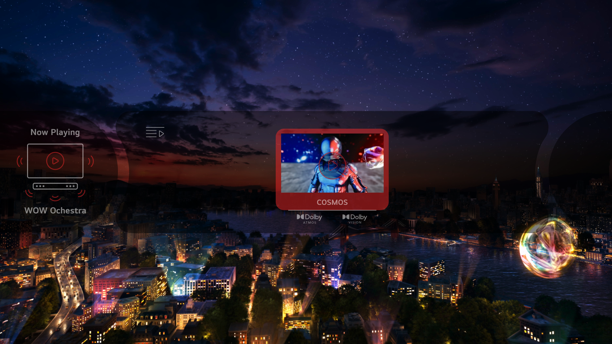
Key Updates
Installation method of Demo App USB is changed for stable USB operation.
Do not insert any other USBs to TV except Demo USB and Sound Switcher.
2025 vs. 2026 Demo Content Comparison
2025
2026
2025 : Demo Content 1 (Cosmos)
2026 : Total 3 contents for 2026
Demo content
① What is WOW Orchestra?
2026 : Total 3 contents for 2026
① What is WOW Orchestra? : Brand New
* Playback mode: WOW Orchestra only
* TV<->WOW output switching: Not supported
② Cosmos : The same as 2025
③ Africa Unseen : Brand New
② Cosmos
③ Africa Unseen
2026 Sound Switcher In-store Guideline
8
LG INTERNAL USE ONLY

Slide 9
Key Updates
Demo content and UI Design for 2026 version.
New Function Update
Demo App USBs
or
or
Automatic background video playback when a thumbnail is selected
When navigating thumbnails using the arrow keys, the video for the selected thumbnail automatically plays in the background.
If no further selection is made, the thumbnail screen disappears after 15 seconds while the video continues to play.
When the OK button is selected, the thumbnail screen disappears immediately, and the video restarts from the beginning.
Due to the unstable USB supply situation this year, we have prepared three different types of USBs.
1) OLED USB, 2) MRGB/QNED USB, 3) All-TV USB (compatible with OLED/MRGB/QNED)
We will distribute the USBs to each subsidiary according to the requested quantities,
so we kindly ask you to carefully check the USB labels before use.
* The appearance of the USB storage device may vary by region.
2026 Sound Switcher In-store Guideline
9
LG INTERNAL USE ONLY

Slide 10
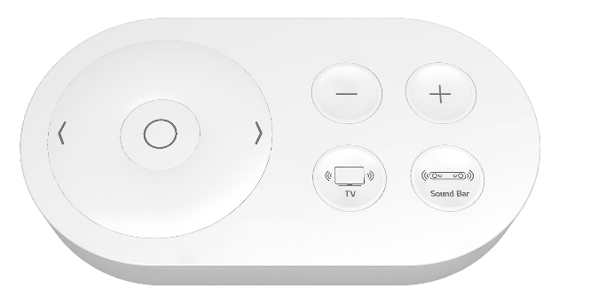
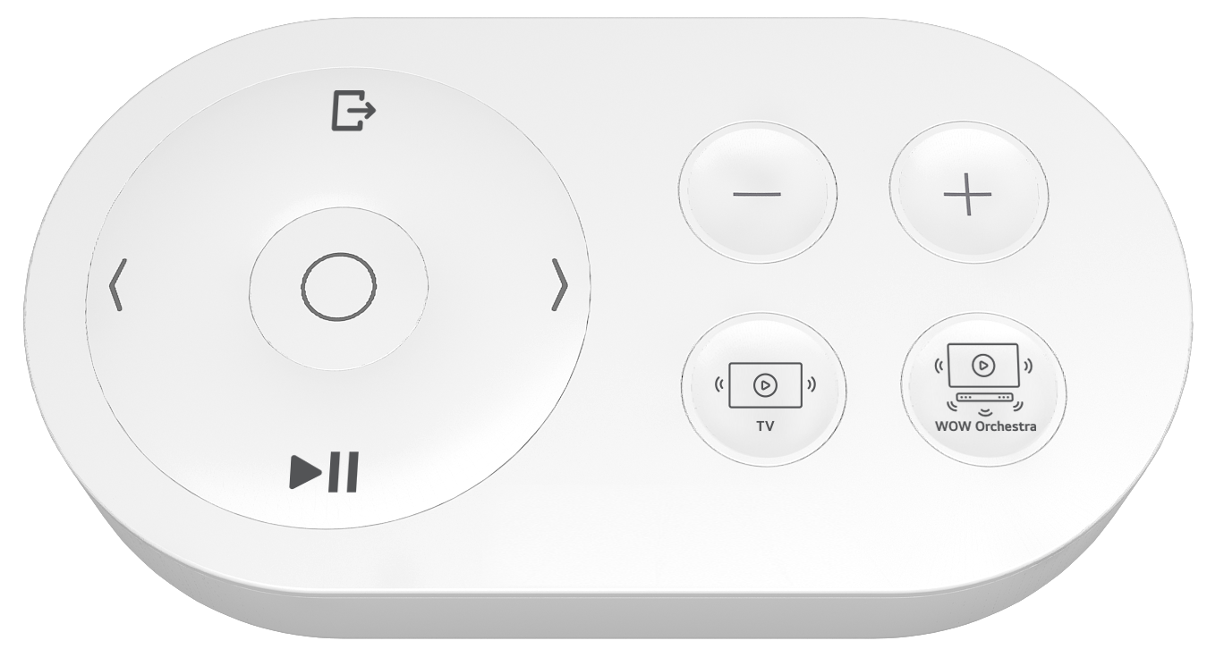
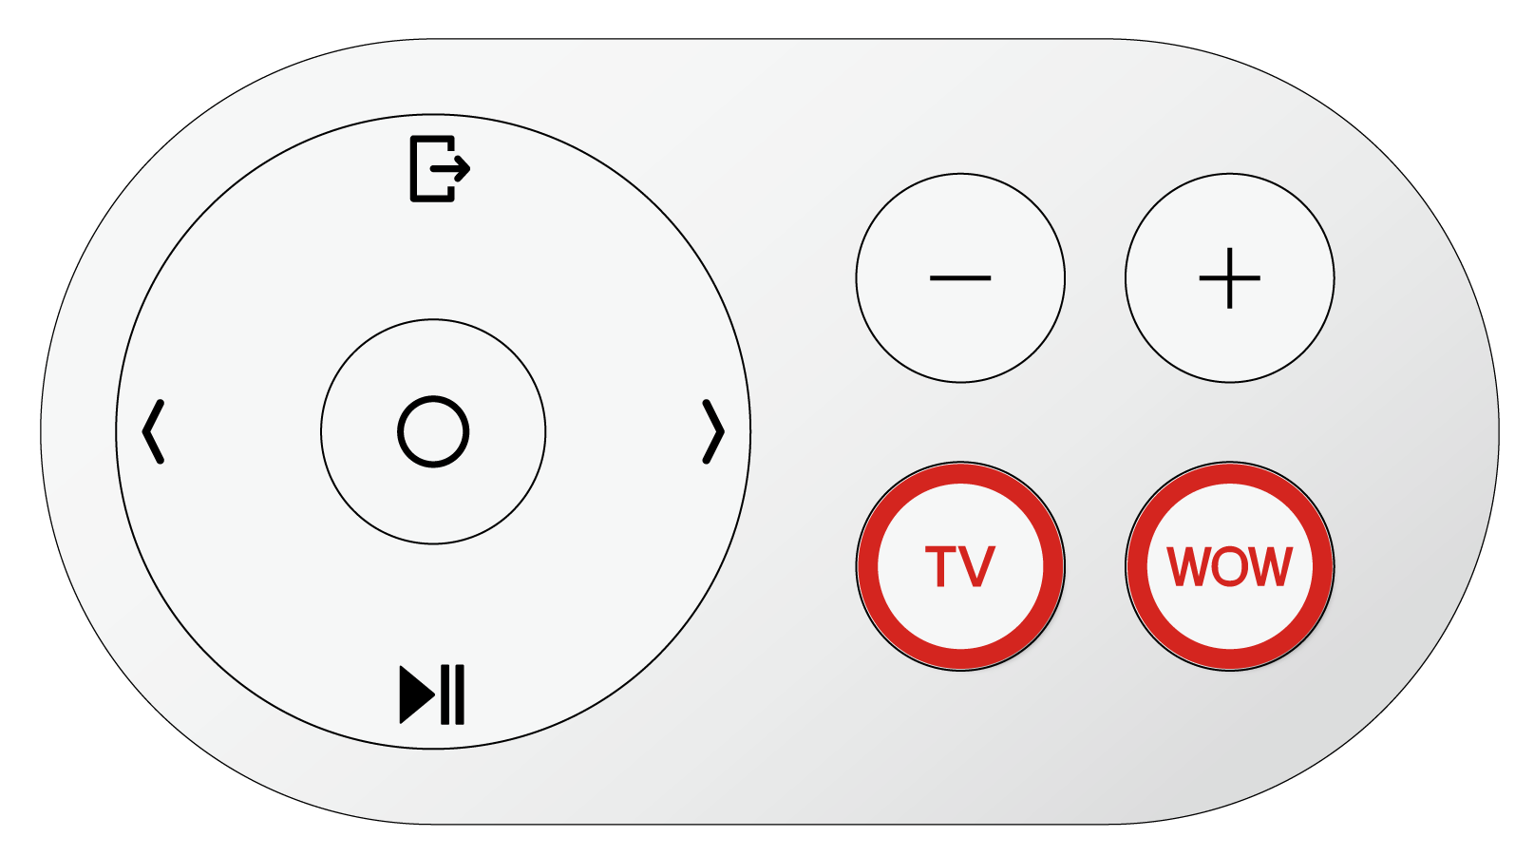
Key Updates
Two demo contents have been added, and all other functions and specifications are carried over from 2025.
Switcher Device
Year | 2023
Sound experience mode | TV vs Soundbar
Volume adjustment | 10 ~ 40 * For Soundbar
Demo content | 14 ea
Button features | 7 functions
Pop-up message | Induce experience “Experience WOW Orchestra”
2024
TV vs WOW Orchestra
0 ~ 100 * Volume control level was updated for both TV & Soundbar (+/- 5)
4 ea
9 functions * EXIT and PLAY / PAUSE buttons added
Induce experience & Show sound mode (TV or WOW)
2025 & 2026
TV vs WOW Orchestra
0 ~ 100 * Volume control level was updated for both TV & Soundbar (+/- 5)
1ea ➔ 3 ea Cosmos ➔ What is WOW Orchestra?, Cosmos, Africa Unseen
9 functions * EXIT and PLAY / PAUSE buttons added
Induce experience & Show sound mode (TV or WOW)
2025
CARRY OVER
2025
CARRY OVER
2025
CARRY OVER
2025
CARRY OVER
2026 Sound Switcher In-store Guideline
10
LG INTERNAL USE ONLY

Slide 11
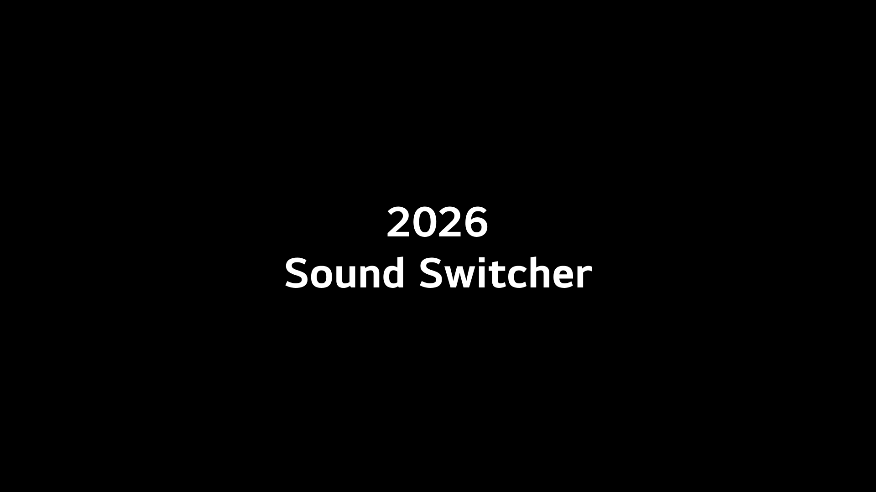
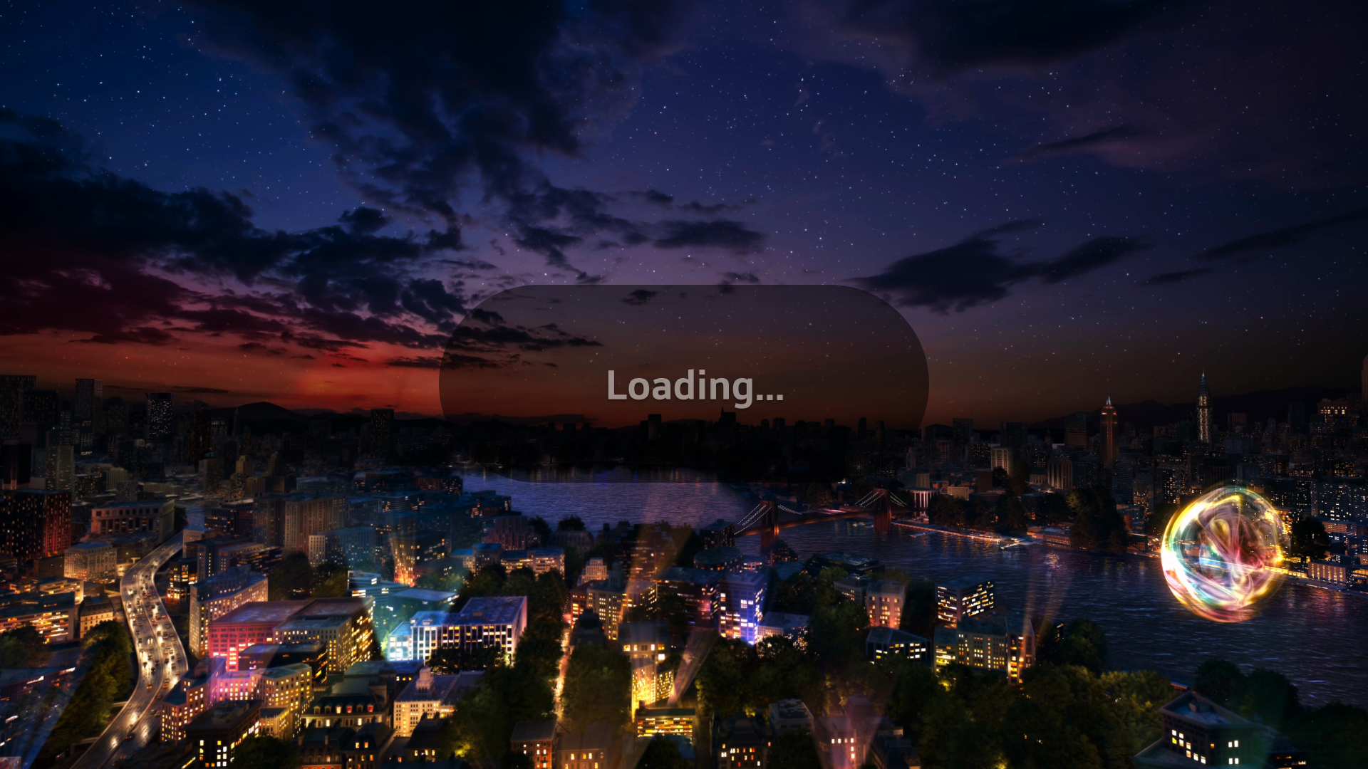
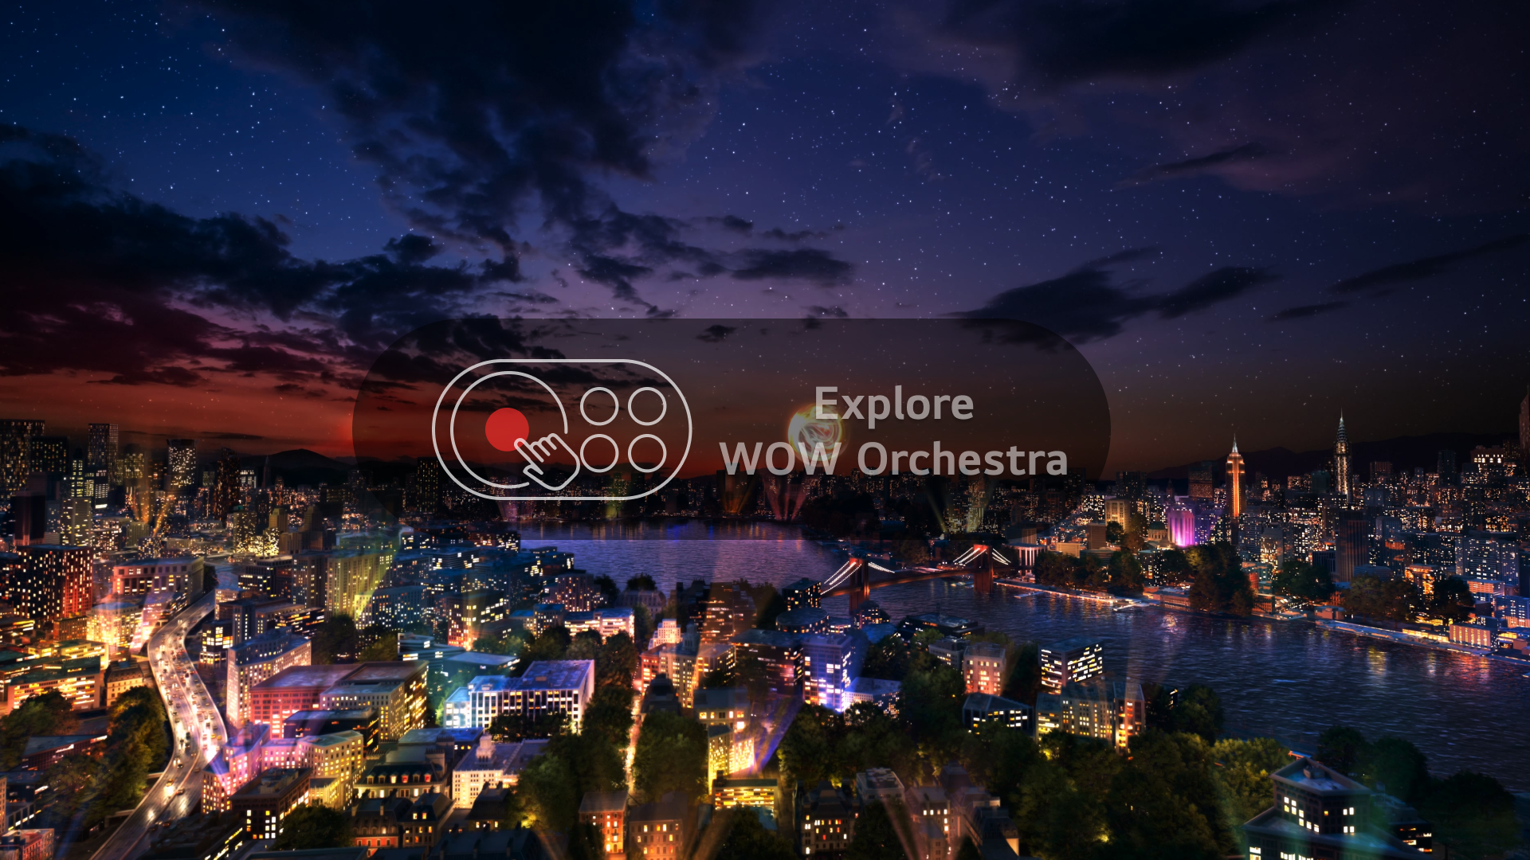
Basic Functions
For a stable demo experience, the same core features as the 2025 version are provided.
Basic Functions
Automatic TV in-store mode setting
Automatic re-launch of Demo app
Automatic skip of damaged TV demo content
Insert Demo App USB into TV,
and Store Mode will be set automatically.
When you exit Demo App, it will be restarted in 2 minutes.
If there is a damaged file in TV demo contents,
it will be skipped automatically.
➊ TV Power on :
Demo Kit Operates
Automatically
Demo Video File
Demo
Re-Launch
in 2min.
➋ Loading Demo App
DAMAGED
Demo Video File
AUTOMATIC SKIP
➌ Idle Mode :
Playing TV
Demo Contents
After 1 min.
without any action
Demo Video File
2026 Sound Switcher In-store Guideline
11
LGE INTERNAL USE ONLY

Slide 12
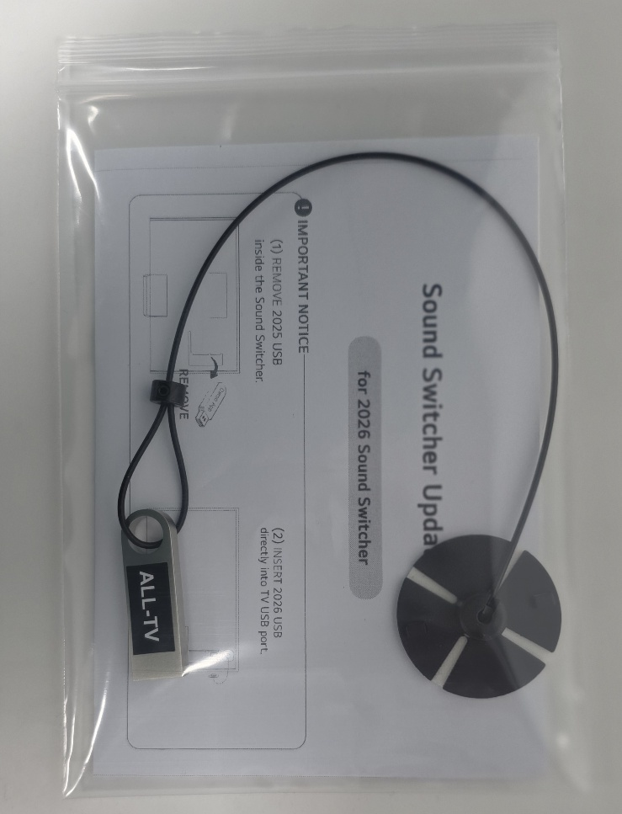
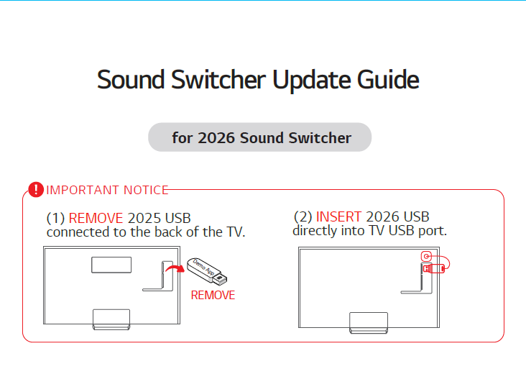
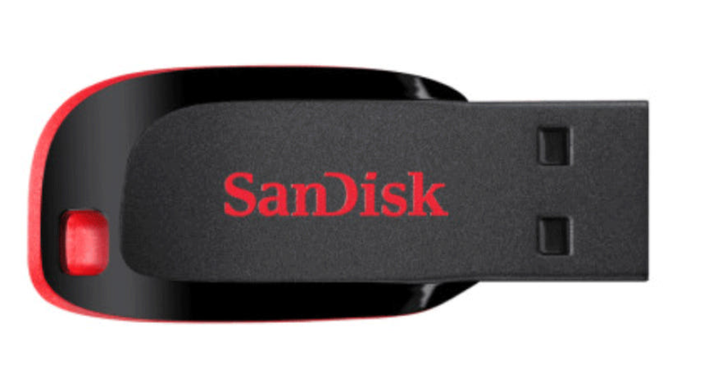

Components_Update Kit
The following components are provided.
Make sure all components are included in the kit before start updating the Sound Switcher.
2026 Sound Switcher compatible products : [TV] (2025) OLED G/C series, QNED92 / QNED90 / QNED85 (2026) OLED G/C series, MRGB95B / MRGB9MB, QNED90B / QNED85B
[Soundbar] S70T series or above models
2026 Update Kit Package
① Sound Switcher Update Guide
② Demo App USB [OLED] or [MRGB/QNED]
OLED
MRGB/QNED
ALL-TV
* The demo app USB will be provided as either OLED or MRGB/QNED
USB memory, depending on the country requirements.
(Not all USB drives are included in the update kit.)
※ If components are missing or additional purchase is needed, contact Rydis (+82 70 8671 2210 or rydis-cs@rydis.co.kr) / HSAD (+82 2 705 3828 or kyh2013@hasd.co.kr) for support
2026 Sound Switcher In-store Guideline
12
LG INTERNAL USE ONLY

Slide 13
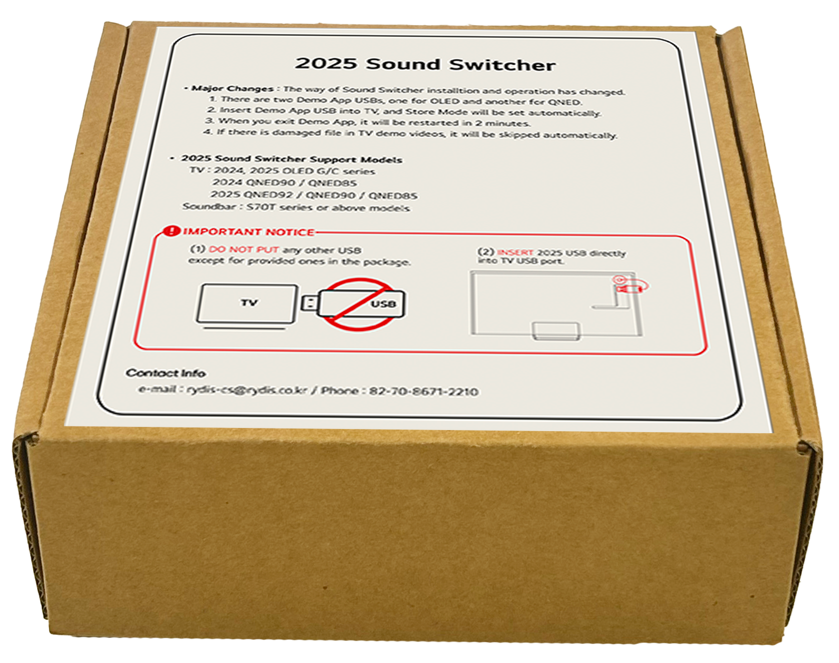
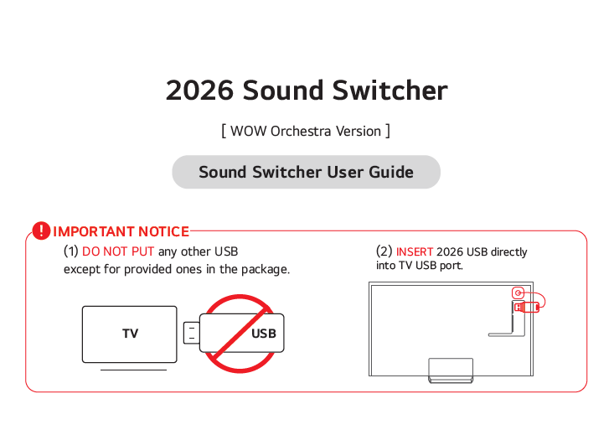
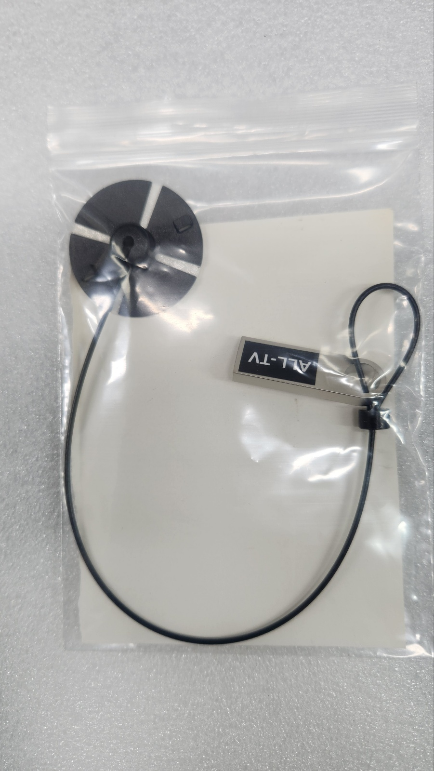

Components_New Device
The following components will be provided. Make sure all components are included in the set before installing the
new Sound Switcher.
2026 Sound Switcher compatible products : [TV] (2025) OLED G/C series, QNED92 / QNED90 / QNED85 (2026) OLED G/C series, MRGB 95B / MRGB 9MB, QNED 90B / QNED85B
[Soundbar] S70T series or above models
2026 Sound Switcher New Set Package
① Sound Switcher device
② Sound Switcher User Guide
④ Demo App USB
③ Screw x 2EA
* The demo app USB is provided as a unified
version and includes a single USB drive.
It supports all compatible TV models with the
corresponding USB.
* No USB inside
※ If components are missing or additional purchase is needed, contact Rydis (+82 70 8671 2210 or rydis-cs@rydis.co.kr) / HSAD (+82 2 705 3828 or kyh2013@hasd.co.kr) for support
2026 Sound Switcher In-store Guideline
13
LG INTERNAL USE ONLY

Slide 14
Sound Switcher Installation
Precaution
2026 Sound Switcher Installation Guide
02

Slide 15
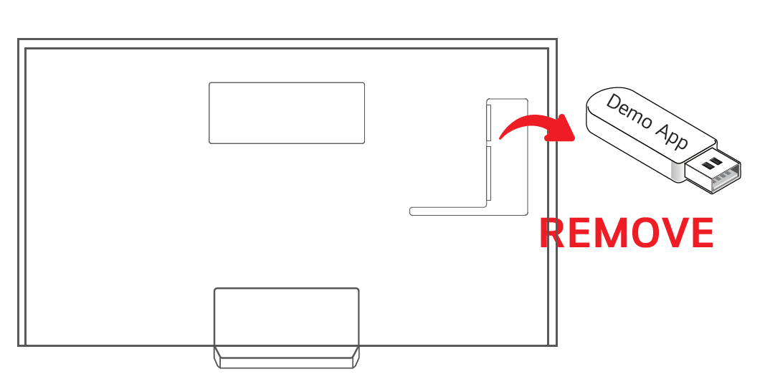
Precaution
Be sure to check the guide below before installing 2026 Sound Switcher.
Check in Advance
REMOVE 2025 USB memory
from the TV before installation
DO NOT PUT any other USB
except Demo USB and Sound Switcher
DO NOT USE TV or Soundbar Remote controller while experiencing demo
1
DEMO
TV
TV
USB IN
2
DO NOT CONTROL sound volume with Soundbar button.
Use Sound Switcher device instead.
OTHER USB
2026 Sound Switcher In-store Guideline
15
LGE INTERNAL USE ONLY

Slide 16
Sound Switcher Installation Guide
Be sure to follow the process below.
Step 1. Remove 2025 USB memory
Step 2. . Insert 2026 Demo USB
Remove existing 2025 USB memory before installation.
Insert Demo USB and Switcher Device into TV USB Port.
Demo App USB
Sound Switcher USB
Attach the USB sticker pad to the empty space on the back of the TV.
REMOVE ALL Other USBs or Flash Drives from TV
for stable Sound Switcher demo
Sticker Pad
2026 Sound Switcher In-store Guideline
16
LGE INTERNAL USE ONLY

Slide 17
Sound Switcher Demo
Explanation of Switcher Device Buttons
2026 Demo Content
Scenario 1. Entering Demo Mode
Scenario 2. TV <-> WOW Orchestra
Scenario 3. Error pop-up message
03

Slide 18
Explanation of Switcher Device Buttons
Make sure to fully understand the functions of each button for demonstration.
① Browse Content (Left/Right)
- Browse and select content by moving left and right
* When buttons are selected during demo video playback, the thumbnail screen appears
② Select Content
- Play the content
* When button is selected during demo video playback, the thumbnail screen appears
7
4
4
2
③ Play/Pause
- Play or pause the content
1
1
④ Volume Control (- / + 5 Level)
- Adjust volumes (Default setting of sound volume is 20)
3
⑤ Select Audio Output : TV Speaker
- Move to TV Speaker experience mode
5
6
⑥ Select Audio Output : WOW Orchestra
- Move to WOW Orchestra experience mode
⑦ Exit to TV Demo Mode (Idle Mode)
- Switch to TV Demo Mode which shows the demo contents
2026 Sound Switcher In-store Guideline
18
LGE INTERNAL USE ONLY

Slide 19

2026 Demo Content
WOW Orchestra Introduction Video (Exclusive WOW Orchestra Mode)
For powerful WOW Orchestra experience, two contents ‘COSMOS‘ and ‘Africa Unseen’ will be run which was audio-tuned for the best sound
Must be used as HQ distributed video file, additional editing is not permitted
[ What is WOW Orchestra? ]
[ COSMOS ]
[ AFRICA UNSEEN ]
Dolby V/A
HDR
Dolby V/A
HDR
Highlights WOW Orchestra through a comparison of visuals and audio
Emphasize Dolby Atmos’s object-based 3D surround sound
Brings animal, aircraft, and automotive sounds to life with rich soundscapes
2026 Sound Switcher In-store Guideline
19
LG INTERNAL USE ONLY

Slide 20
Scenario 1. Entering Demo Mode
1. TV Power On : Run Demo App
2. Loading Demo App
3. TV Store Mode : Play TV Demo Contents
When the TV is turned on, the demo app automatically runs.
"Loading" pop-up message appears.
Buttons do not work to prevent malfunction.
TV Demo contents are played automatically.
* Sound Switcher recognizes the connected TV model
(OLED or MRGB/QNED) and plays matched demo contents
4. Switcher Demo Mode: Display content menu
5. Switcher Demo Mode : Change audio output
* If there is no user input for 60 seconds,
Sound Switcher automatically returns to IDLE mode (=TV demo contents are played).
* E-Streamers are not displayed when Sound Switcher is connected to TV.
When the button is pressed, content menu is displayed.
Shows audio output status (Default : WOW Orchestra with volume 20)
Play the selected demo content and switch
between TV speaker vs WOW Orchestra
2026 Sound Switcher In-store Guideline
20
LGE INTERNAL USE ONLY

Slide 21
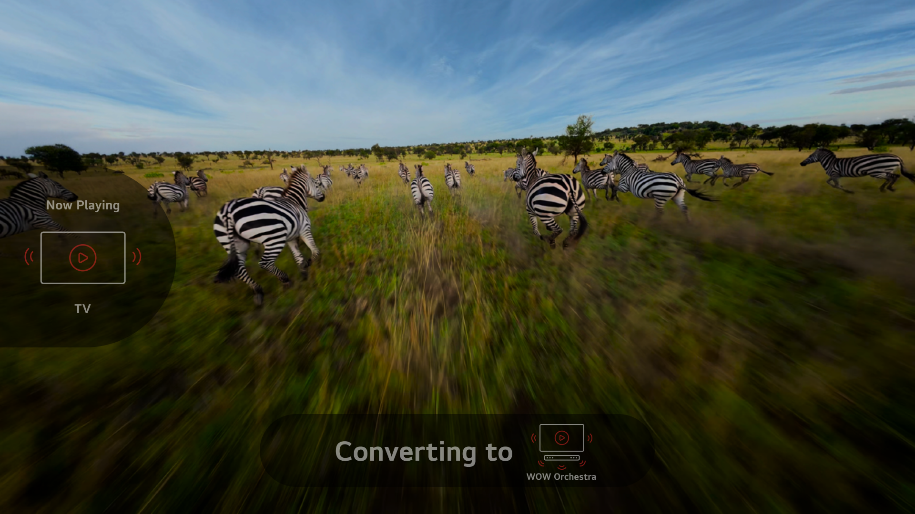
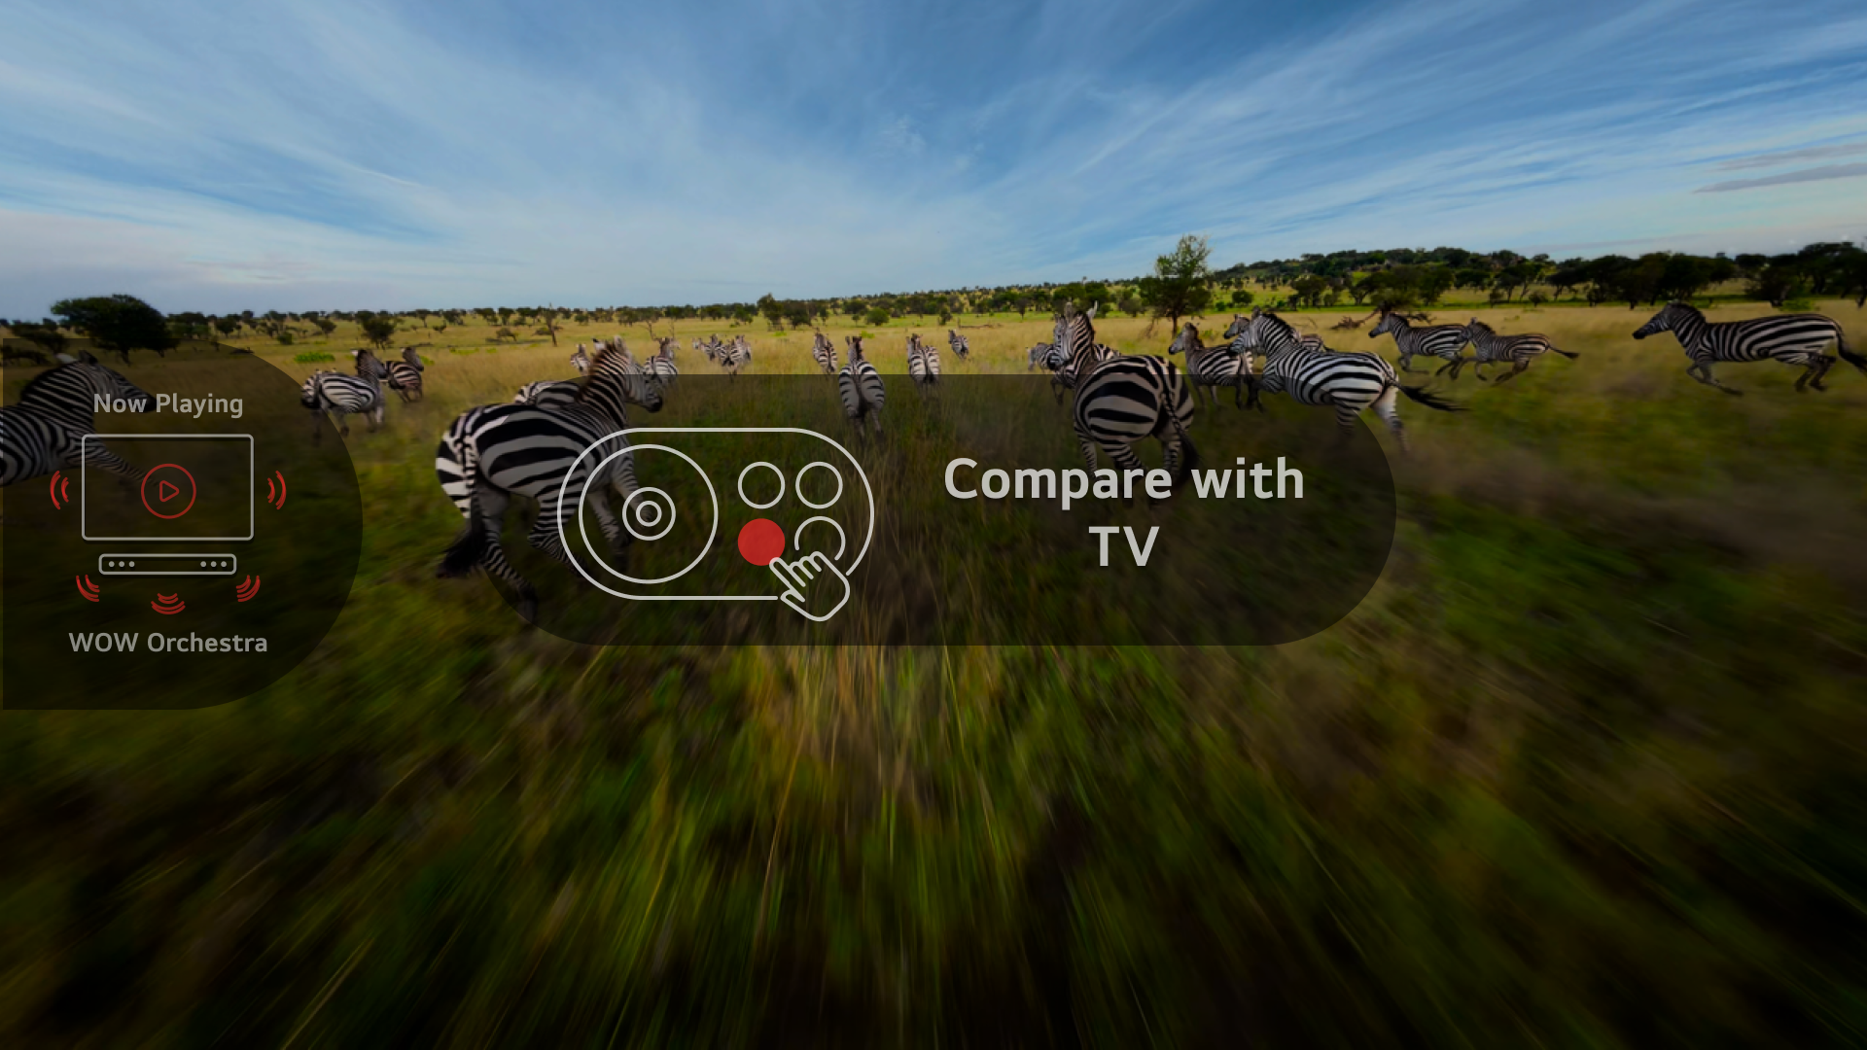
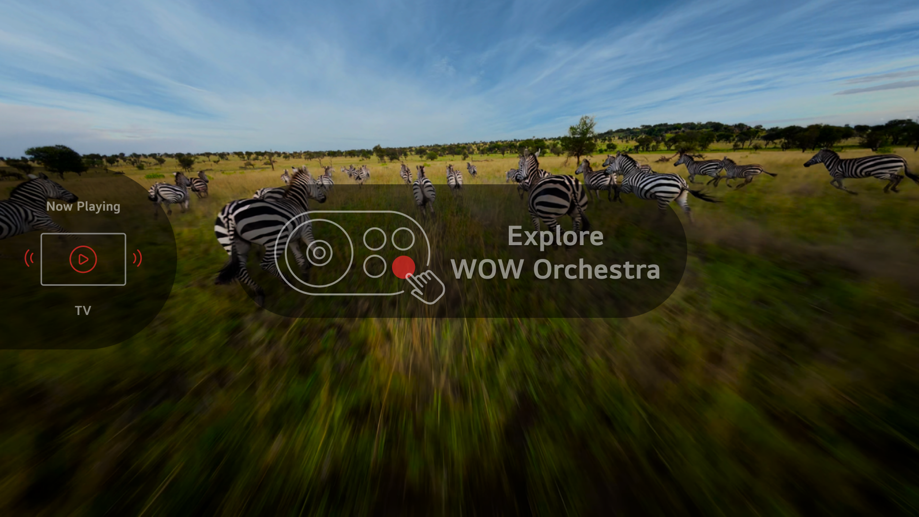
Scenario 2. TV WOW Orchestra
Switcher Demo Mode
If you select a demo content,
the main menu immediately disappears.
Default demo setting is TV speaker mode with volume 20.
Switching Audio Output (TV → WOW Orchestra)
* It takes 2-3 sec. when sound demo is changed to WOW Orchestra
No ‘Converting to’ pop-up
Audio output is switched to WOW Orchestra.
Switching Audio Output (WOW Orchestra → TV)
Audio output is switched to TV.
2026 Sound Switcher In-store Guideline
21
LGE INTERNAL USE ONLY

Slide 22
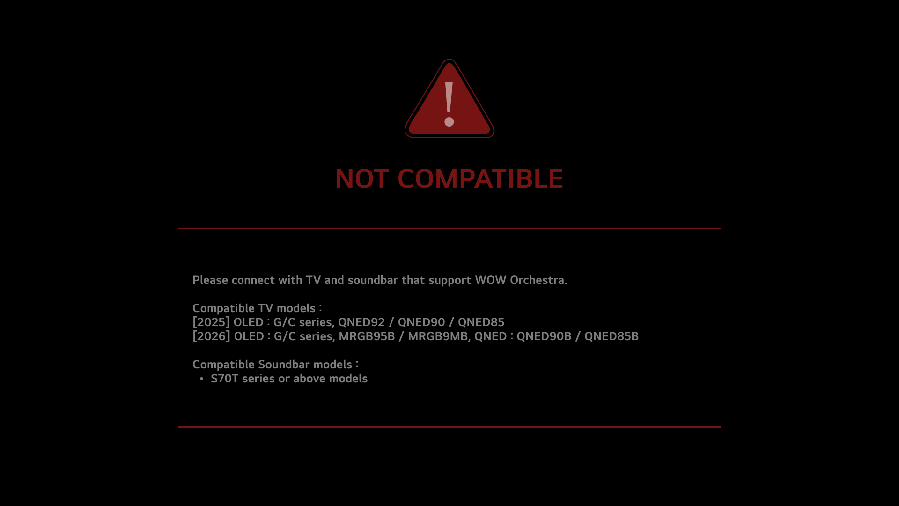
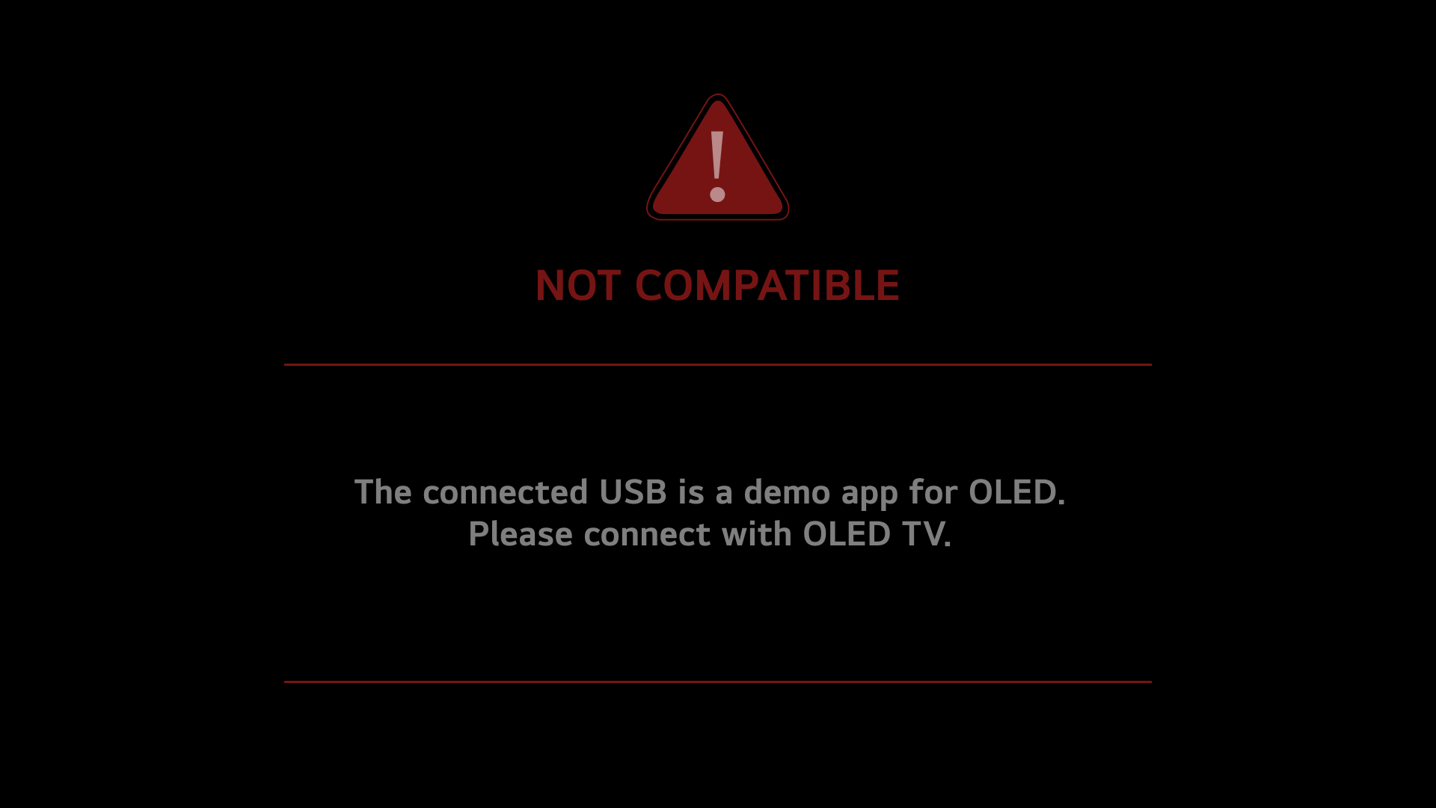
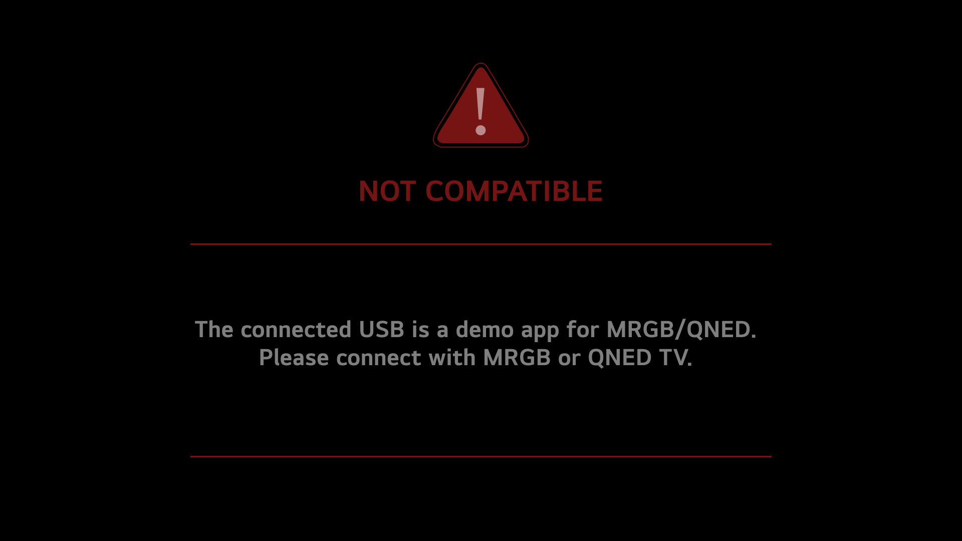
Scenario 3. Error pop-up message
Case 1. When you install Sound Switcher with unsupported models
Warning message appears right away, when connected to unsupported models.
*Supported models :
[TV] [2025] OLED : G/C Series, QNED92 / QNED90 / QNED85
[2026] OLED : G/C Series, MRGB95B / MRGB9MB, QNED90B / QNED85B
[Soundbar] S70T series or above models
Upon turning on the TV, the demo app runs automatically,
and the title message appears (only for the first time).
Case 2. When you insert Demo APP USB into mismatched TV
Upon turning on the TV, the demo app runs automatically,
and the title message appears (only for the first time).
When OLED USB is connected to MRGB/QNED TVs
When MRGB/QNED USB is connected to OLED TVs
2026 Sound Switcher In-store Guideline
22
LGE INTERNAL USE ONLY

Slide 23
FAQ
Troubleshooting & Maintenance
FAQ
04

Slide 24
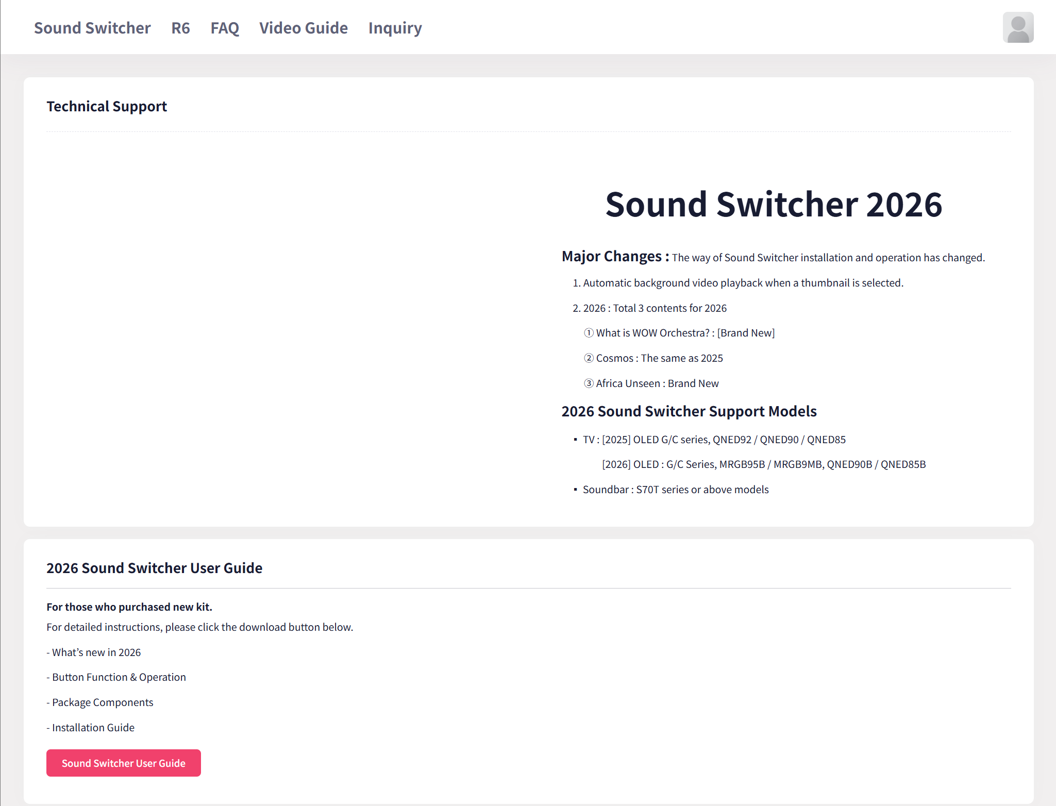
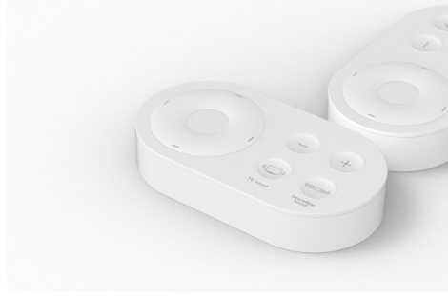
Troubleshooting & Maintenance
More Detailed Guide provided on website below
Link : http://www.lg-instore-support.com/soundswitcher
2026 Sound Switcher User Guide
2026 Sound Switcher Update Kit Guide
Soundbar Demo Mode Setting Guide
* Contact Rydis (+82 70 8671 2210 or rydis-cs@rydis.co.kr) for additional inquires or technical support
2026 Sound Switcher In-store Guideline
24
LGE INTERNAL USE ONLY

Slide 25
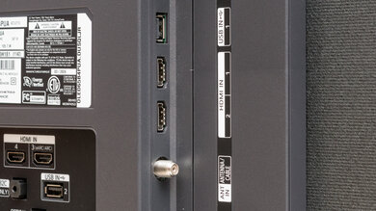

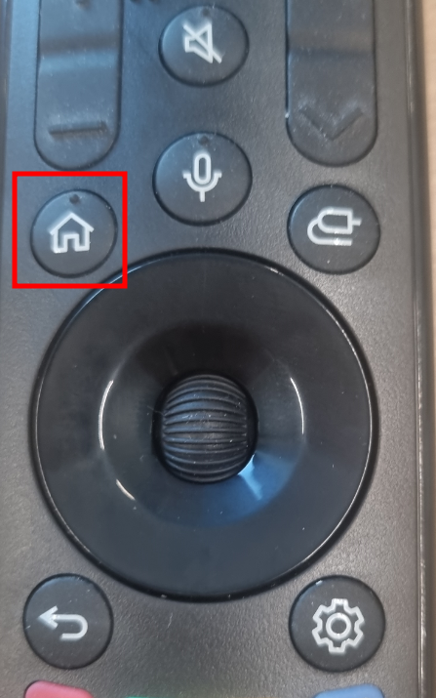
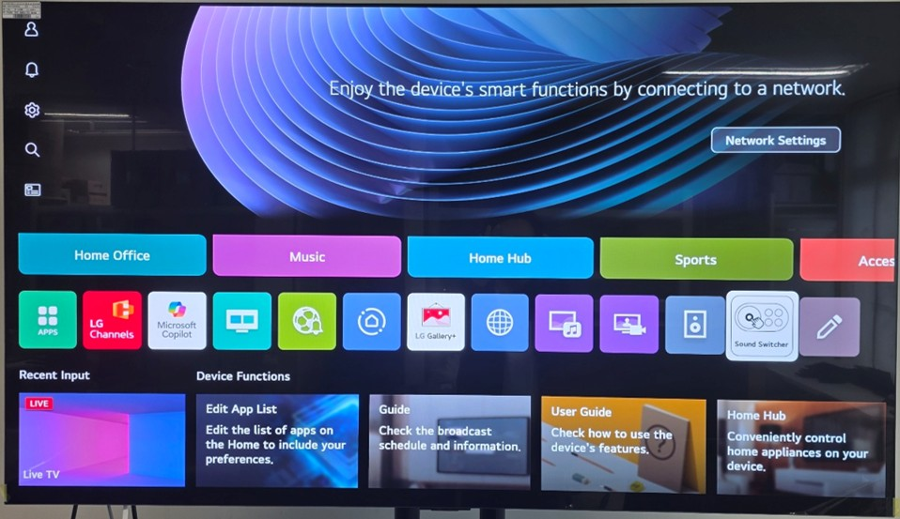
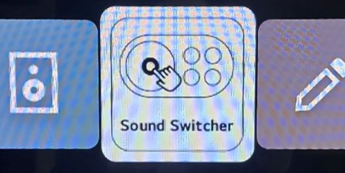
Troubleshooting & Maintenance
Power & Compatibility
- Ensure both the TV and Soundbar are connected to power and turned-on.
- Check 2026 Sound Switcher Supported models :
[TV] (2025) OLED G/C series, QNED92 / QNED90 / QNED85 (2026) OLED G/C series, MRGB95B / MRGB9MB, QNED90B / QNED85B
[Soundbar] S70T series or above models
Connection
- Ensure HDMI cable is connected on ARC port both TV and Soundbar
TV ARC port
Soundbar ARC port
Navigation
- Ensure TV is running the Sound Switcher app (Auto-run when switcher is first connected to TV)
If not, go to the webOS homepage, then select the ‘Sound Switcher’ app Icon (Scroll to the far right)
Remote Controller
Press
TV Home Dashboard
2026 Sound Switcher In-store Guideline
25
LGE INTERNAL USE ONLY

Slide 26
FAQ
If Sound Switcher fails to run properly, refer to below cases.
Q1. TV screen connected with Sound Switcher does not show demo UI
Remove all USB
Check
TV model
USB
TV
[TV]
(2025) OLED G/C series, QNED92 / QNED90 / QNED85
(2026) OLED G/C series, MRGB95B / MRGB9MB, QNED90B / QNED85B
[Soundbar] S70T series or above models
➊ Check the supported models
➋ Check if additional USB is connected to TV
* Remove all USBs except Demo App USB and Sound Switcher Device
※ If components are missing or additional purchase is needed, contact Rydis (+82 70 8671 2210 or rydis-cs@rydis.co.kr) / HSAD (+82 2 705 3828 or kyh2013@hasd.co.kr) for support
2026 Sound Switcher In-store Guideline
26
LGE INTERNAL USE ONLY

Slide 27
FAQ
If Sound Switcher fails to run properly, refer to below cases.
Q2. Audio is not working from Soundbar
Soundbar
Update File
Update
Demo
mode
➊ Update Soundbar
➋ Check if Soundbar is set to DEMO mode
* Link : http://www.lg-instore-support.com/soundswitcher
* Link : http://www.lg-instore-support.com/soundswitcher
※ If components are missing or additional purchase is needed, contact Rydis (+82 70 8671 2210 or rydis-cs@rydis.co.kr) / HSAD (+82 2 705 3828 or kyh2013@hasd.co.kr) for support
2026 Sound Switcher In-store Guideline
27
LG INTERNAL USE ONLY

Slide 28
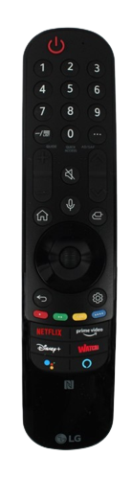
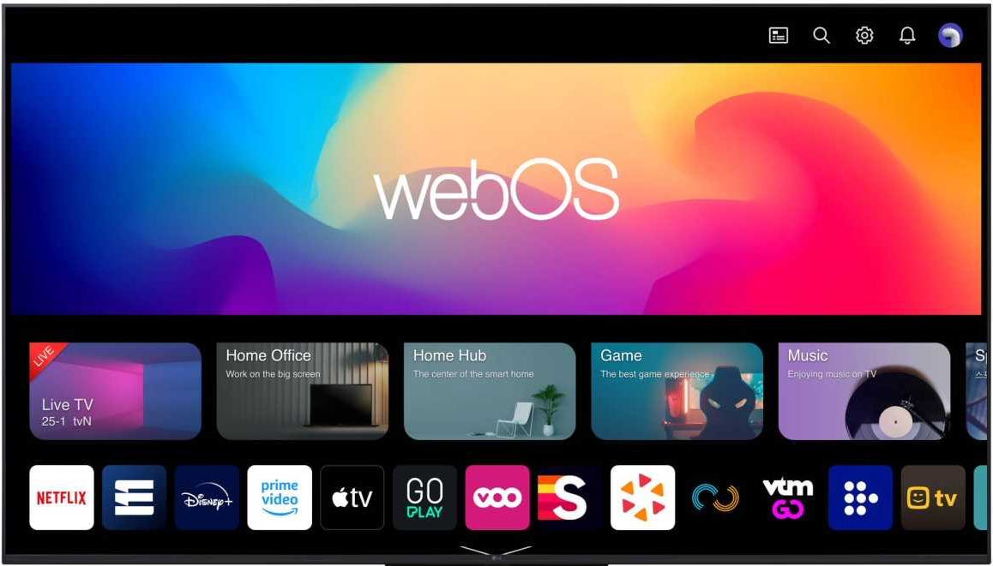

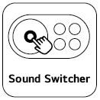

FAQ
If Sound Switcher fails to run properly, refer to below cases.
Q3. TV screen shows either Nothing or No Signal
Home button
➊ Press Home button > App list > Click Sound Switcher app > Re-run DEMO app
※ If components are missing or additional purchase is needed, contact Rydis (+82 70 8671 2210 or rydis-cs@rydis.co.kr) / HSAD (+82 2 705 3828 or kyh2013@hasd.co.kr) for support
2026 Sound Switcher In-store Guideline
28
LGE INTERNAL USE ONLY

Slide 29
FAQ
If Sound Switcher fails to run properly, refer to below cases.
Q4. When “NOT COMPATIBLE” message pops up
When unsupported models are connected
When OLED USB is connected to MRGB/QNED TVs
When MRGB/QNED USB is connected to OLED TVs
➊ Check the compatibility of TV & Soundbar models.
➊ There are designated Demo App USBs for OLED and MRGB/QNED TVs.
❷ Check the sticker label attached to the USB.
※ If components are missing or additional purchase is needed, contact Rydis (+82 70 8671 2210 or rydis-cs@rydis.co.kr) / HSAD (+82 2 705 3828 or kyh2013@hasd.co.kr) for support
2026 Sound Switcher In-store Guideline
29
LGE INTERNAL USE ONLY

Slide 30
Appendix
Purchase Info of 2026 Switcher Device
Contact Info.
05

Slide 31
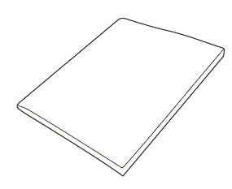
Purchase Info of 2026 Switcher Device
Sound Switcher sets should be purchased by subsidiary with Rydis.
Please refer following information.
Product
Vendor
Components :
1. Sound Switcher
2.Guideline
3. Demo App USB
Rydis Co.,Ltd (라이디스)
[English]
E-mail : rydis-cs@rydis.co.kr
Address : #910, 30, Gasan digital 1-ro, Geumcheon-gu, Seoul,
Republic of Korea (Postal code : 08591)
Contact person : Jang Se-jin
Phone# : +82-70-8671-2210 / +82-10-7572-2401
[Korean]
이메일 : rydis-cs@rydis.co.kr
주소 : 서울특별시 금천구 가산디지털1로,30
에이스하이엔드타워10차 (우:08591)
담당자 : 장세진
전화번호 : 070-8671-2210, 010-7572-2401
* Please also include the HSAD representative in CC when sending the email.
이메일 : yhk2013@hsad.co.kr
담당자 : 강윤호 / Kang Yun Ho
전화번호 : 02-705-3828, 010-7123-2874
4. Screw (2EA)
Price
For separate orders, the unit price may vary depending on the availability of USB memory.
Price : 110,000 KRW
(VAT not included)
Final purchase price is decided depending on
exchange rates at the time of transaction.
Shipping price not included
Price could be different depending on the order quantity.
2026 Sound Switcher In-store Guideline
31
LGE INTERNAL USE ONLY

Slide 32
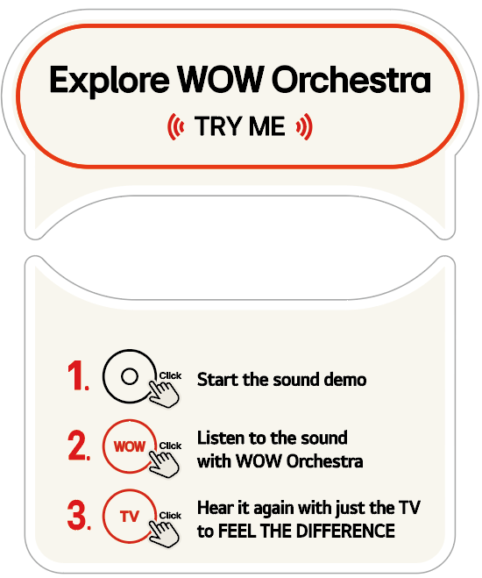
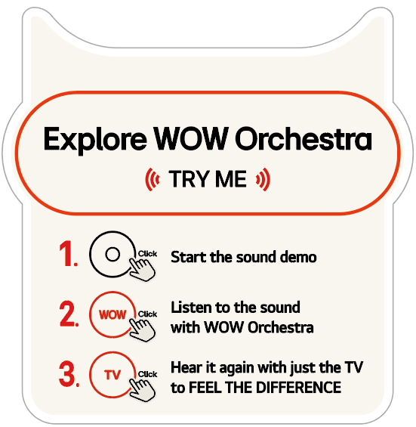

Sound Switcher POP Source
Please find the POP source in DAM and localize it.
* DAM Link : Assets > Files > Master (2024~) > MS > BTL > 2026 > BTL Common > In-store > TV/Soundbar > Soundbar > POP > Soundbar
[Wallmount Type]
Size : 117.5 x 85 mm
Material : Yupo Sheet Print
[Stand Type]
Size : 117.5 x 71 mm
Material : Yupo Sheet Print
2026 Sound Switcher In-store Guideline
32
LGE INTERNAL USE ONLY

Slide 33
Point of Contact
LG Electronics HQ
HS Ad HQ
Vendors
MS Brand Communication Division
MS Brand Experience Team
O2O Marketing Team
Demo
Content
Seowoo Hong
seowoo.hong@lge.com
MS ISM
Yunho Kang
kyh2013@hsad.co.kr
RYDIS
(Demo System)
Byungkuk Han
sales@rydis.co.kr
Inquiry & Troubleshooting
HyoEul Lee
herman09@rydis.co.kr
Inquiry & Troubleshooting
SJ Jang
rydis1@rydis.co.kr
Order & Purchase
2026 Sound Switcher In-store Guideline
33
LGE INTERNAL USE ONLY

